Slide 1

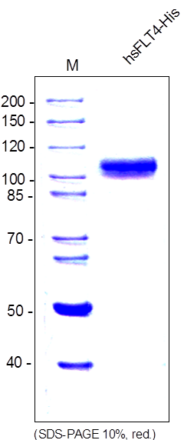
ReliaTech GmbH
Recombinant human soluble FLT-4-His
(Cat #S01-017 / S01-018)
Fig. 1: SDS-PAGE analysis of recombinant human soluble FLT4-His derived from insect cells. Sample was loaded in 10% SDS-polyacrylamide gel under reducing conditions and stained with Coomassie blue.
http://www.reliatech.de / orders@reliatech.de

